Slide 1


U.S. COVID-19 Vaccination Analysis at County Level
Group 3

Slide 2
Table of contents
01
02
03
04
Abstract
Ask a Question
Data Acquisition & Cleaning
Exploratory Data Analysis And Visualization
05
Prediction & Inference
06
Result and Feedback

Slide 3
Abstract
The project aims to efficiently examine COVID-19 immunization data in the US at the county level.
The aim is to identify the factors influencing vaccination rates, investigate community-specific differences, and make recommendations for strategies to increase immunization rates.
The project will employ data mining techniques to extract meaningful insights that will facilitate informed decision-making linked to health

Slide 4

Data Science Life cycle
Ask a Question
Data Acquisition and Cleaning
Exploratory Data Analysis and Visualization
Prediction and Inference

Slide 5
01
Ask a Question
What are the factors that may influence the Covid-19 vaccination rate?

Slide 6
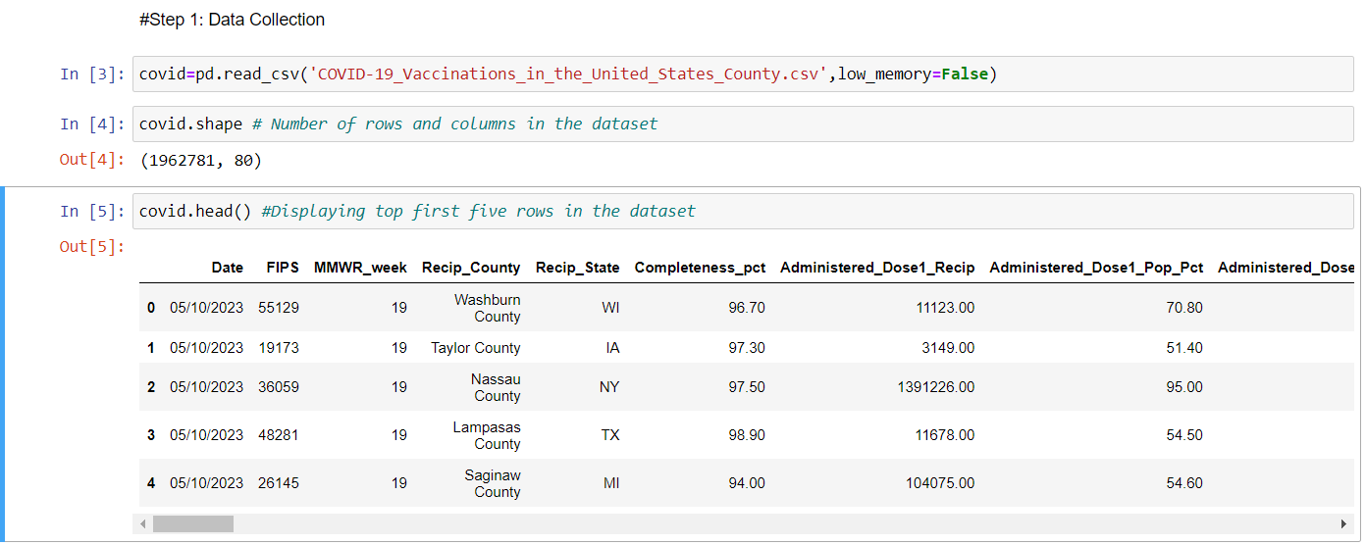
Data Acquisition
https://data.cdc.gov/Vaccinations/COVID-19-Vaccinations-in-the-United-States-County/8xkx-amqh/about_data

Slide 7
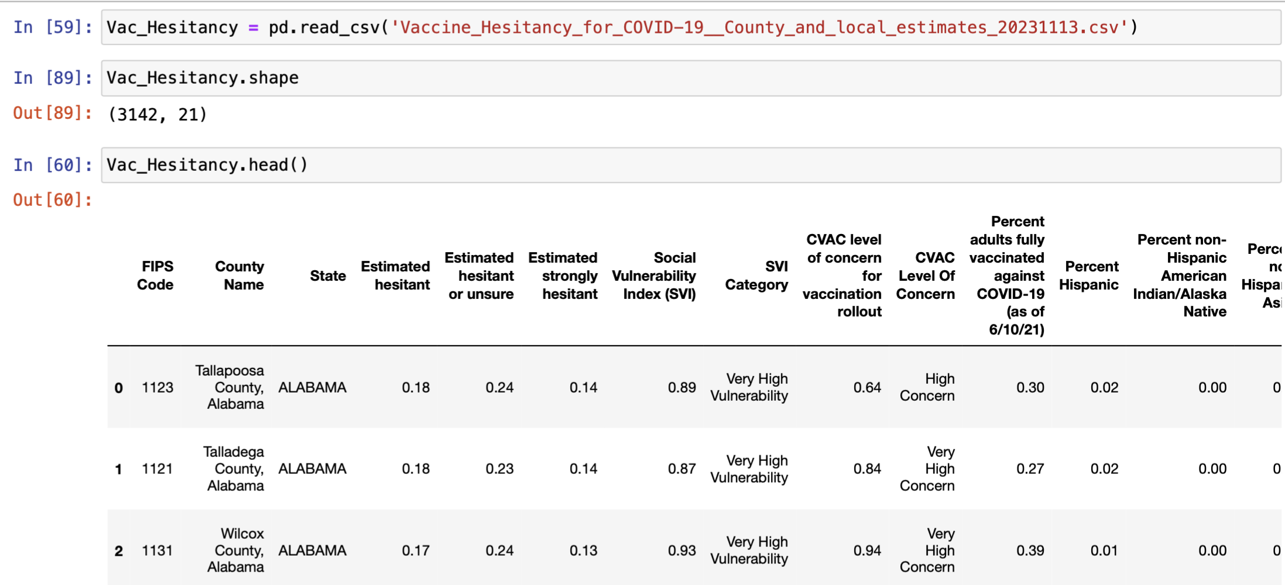
https://data.cdc.gov/Vaccinations/Vaccine-Hesitancy-for-COVID-19-County-and-local-es/q9mh-h2tw/about_data

Slide 8
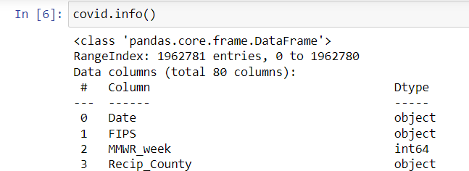
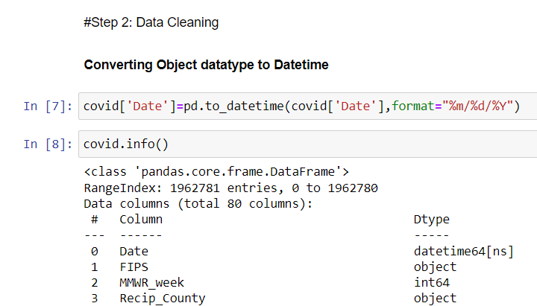
Data Cleaning
Before Cleaning
After Cleaning

Slide 9
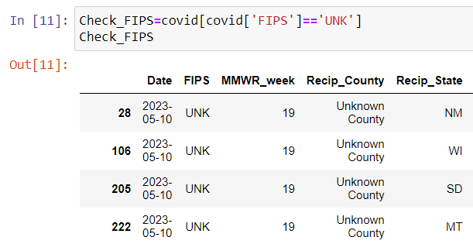
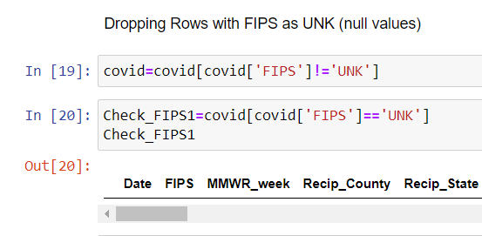
Data Cleaning
Before Cleaning
After Cleaning

Slide 10

Exploratory Data Analysis
& Visualization
Data Merging
Data Exploration
Univariate Analysis
Bivariate Analysis
Multivariate Analysis
Data Visualization

Slide 11
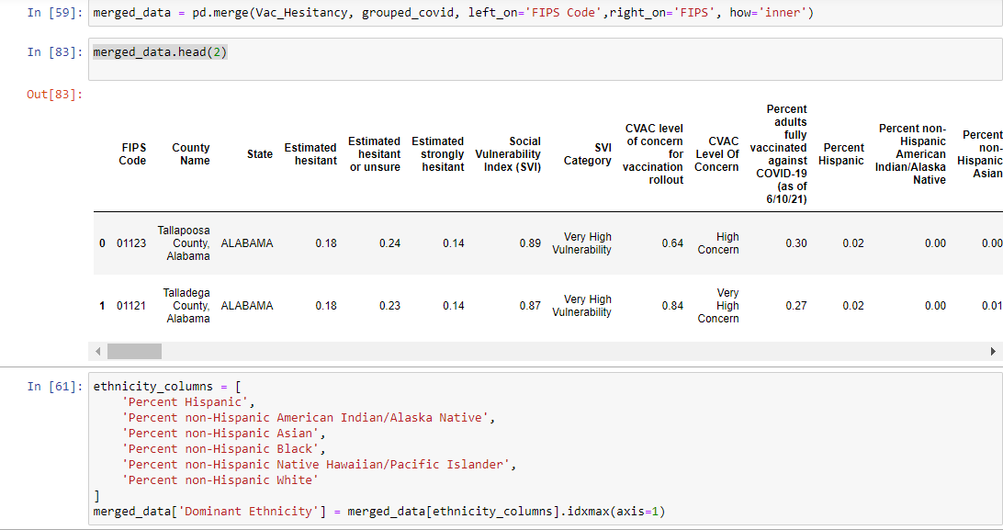
Data Merging
Merging two datasets to indicate the dominance of ethnicity in the COVID-19 vaccination rate at the county level.

Slide 12
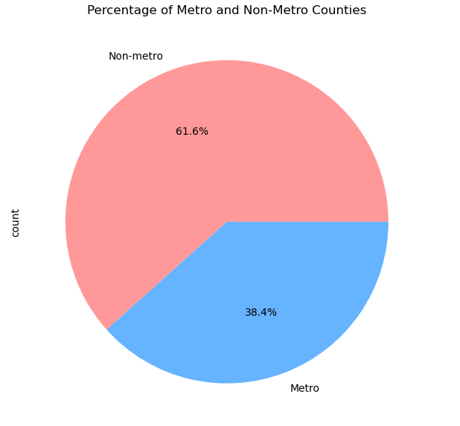
Data Exploration
Univariate Analysis

Slide 13
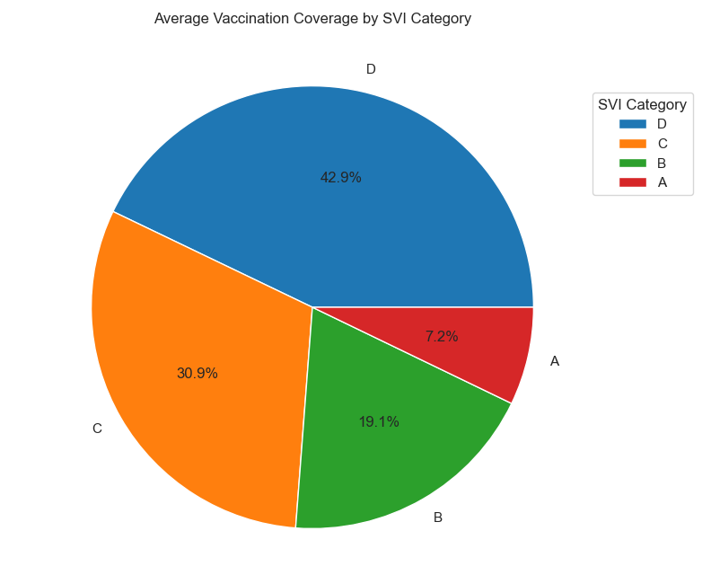
Univariate Analysis

Slide 14
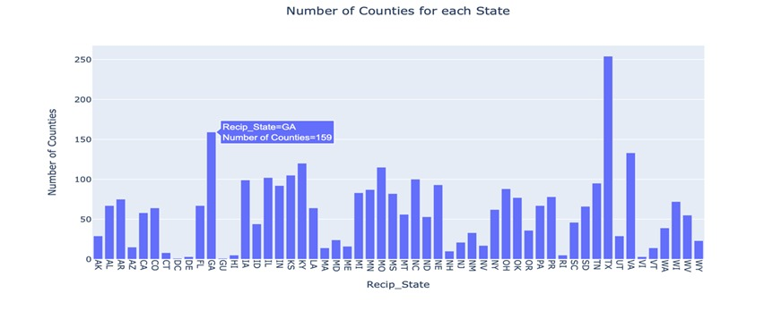
Data Exploration
Bivariate Analysis

Slide 15
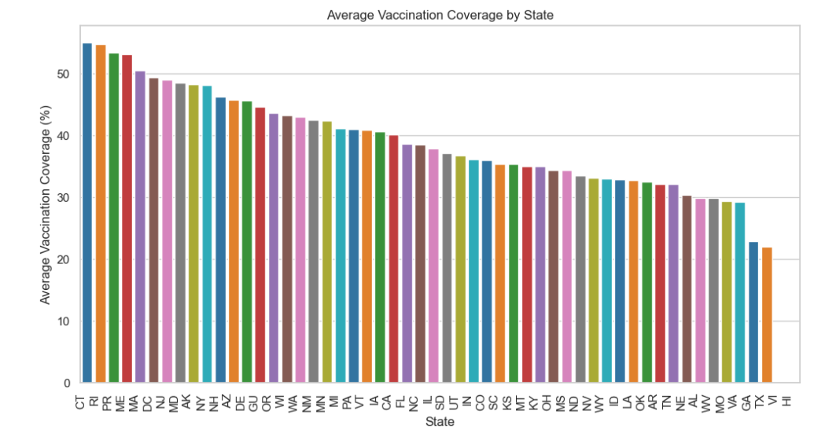
Bivariate Analysis

Slide 16
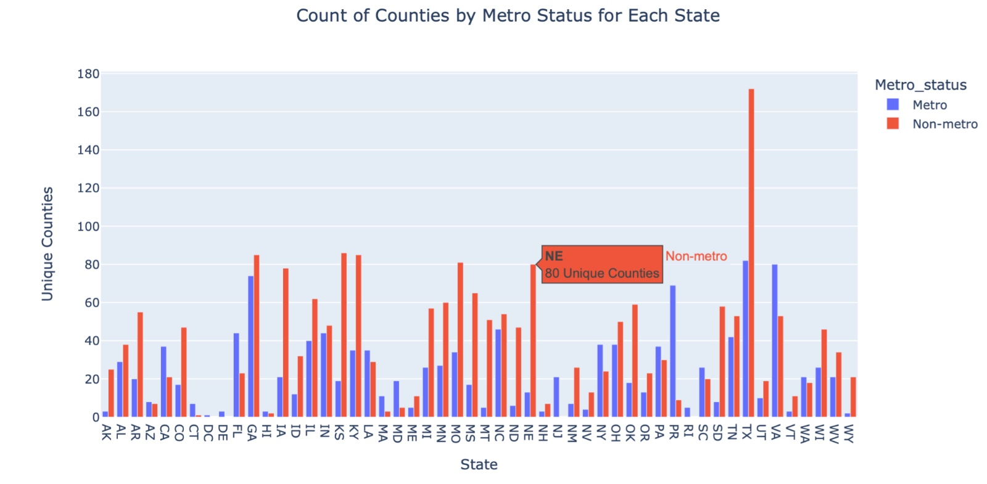
Multivariate Analysis

Slide 17
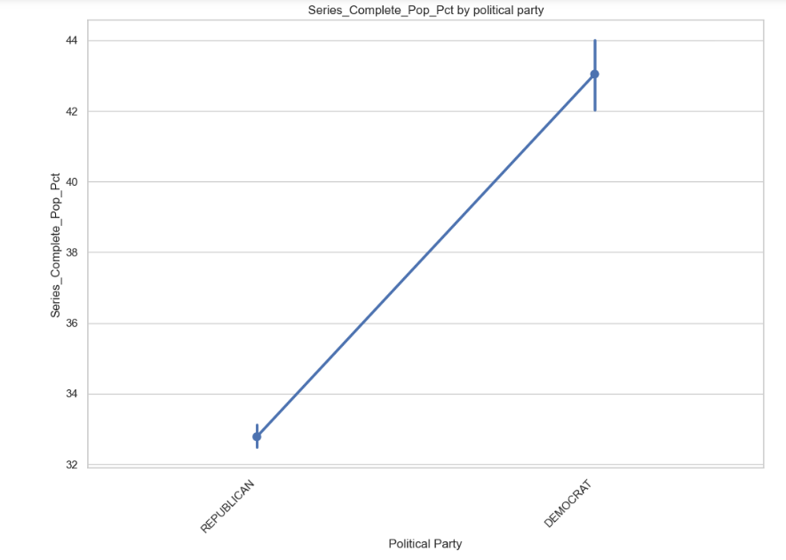
Data Visualization
Political Party vs Series Completion Percentage

Slide 18
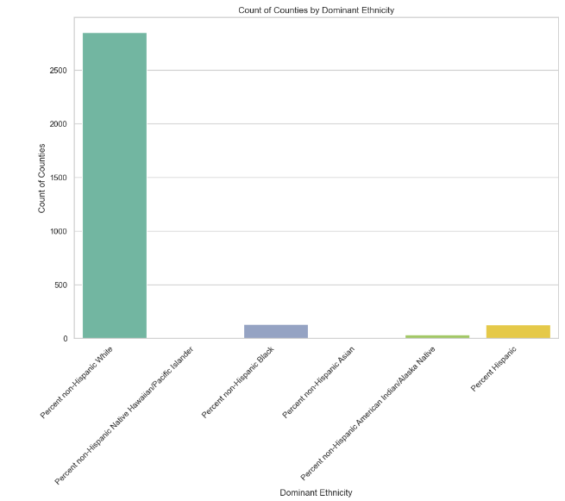
Dominance of Ethnicities in Counties

Slide 19
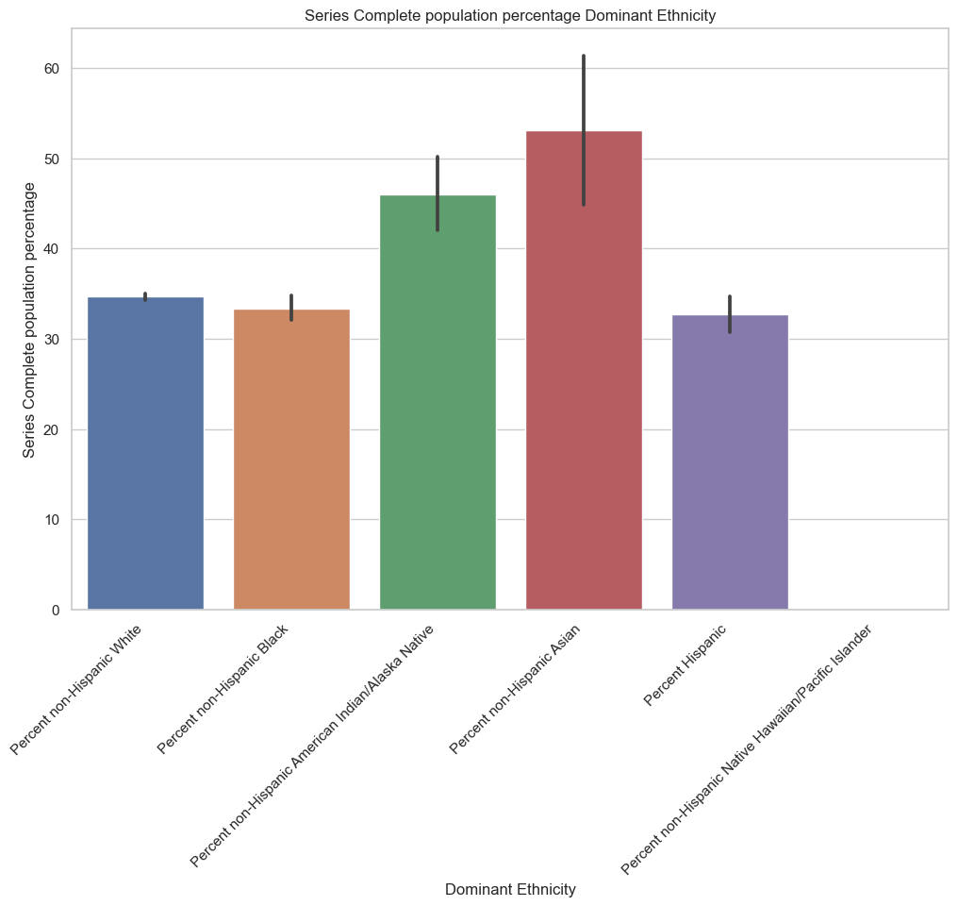
Ethnicity vs Series Completion percentage

Slide 20
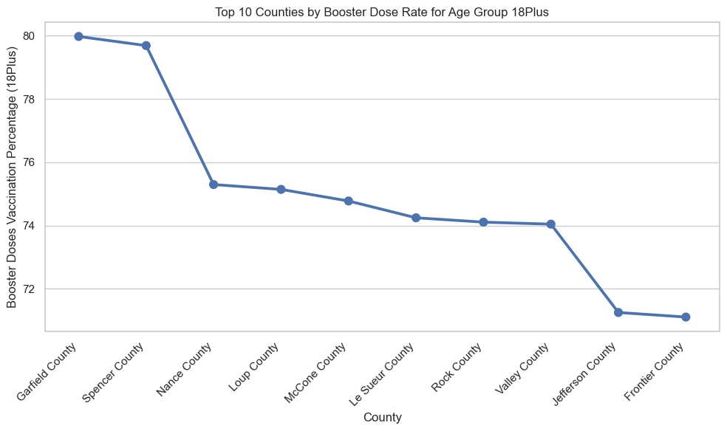
Booster vaccination percentage for top 10 counties

Slide 21
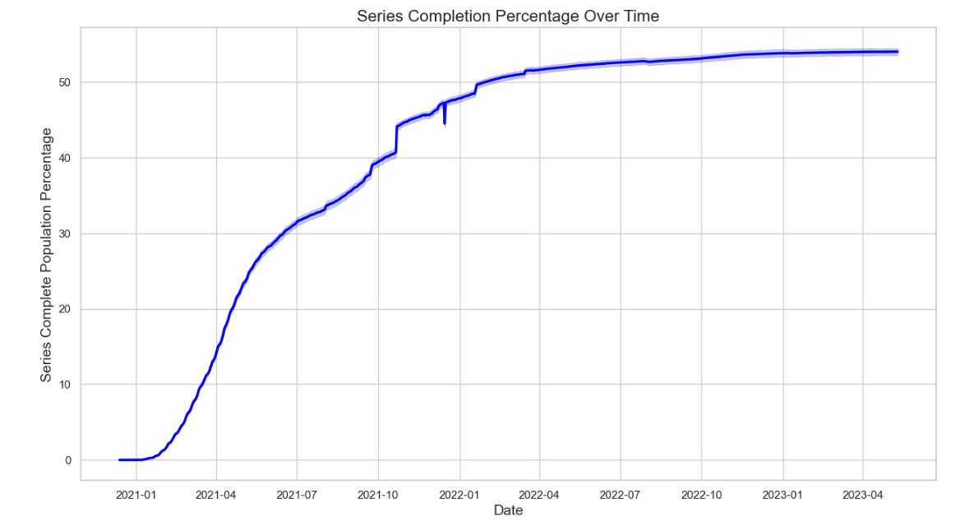
Prediction and Inference

Slide 22
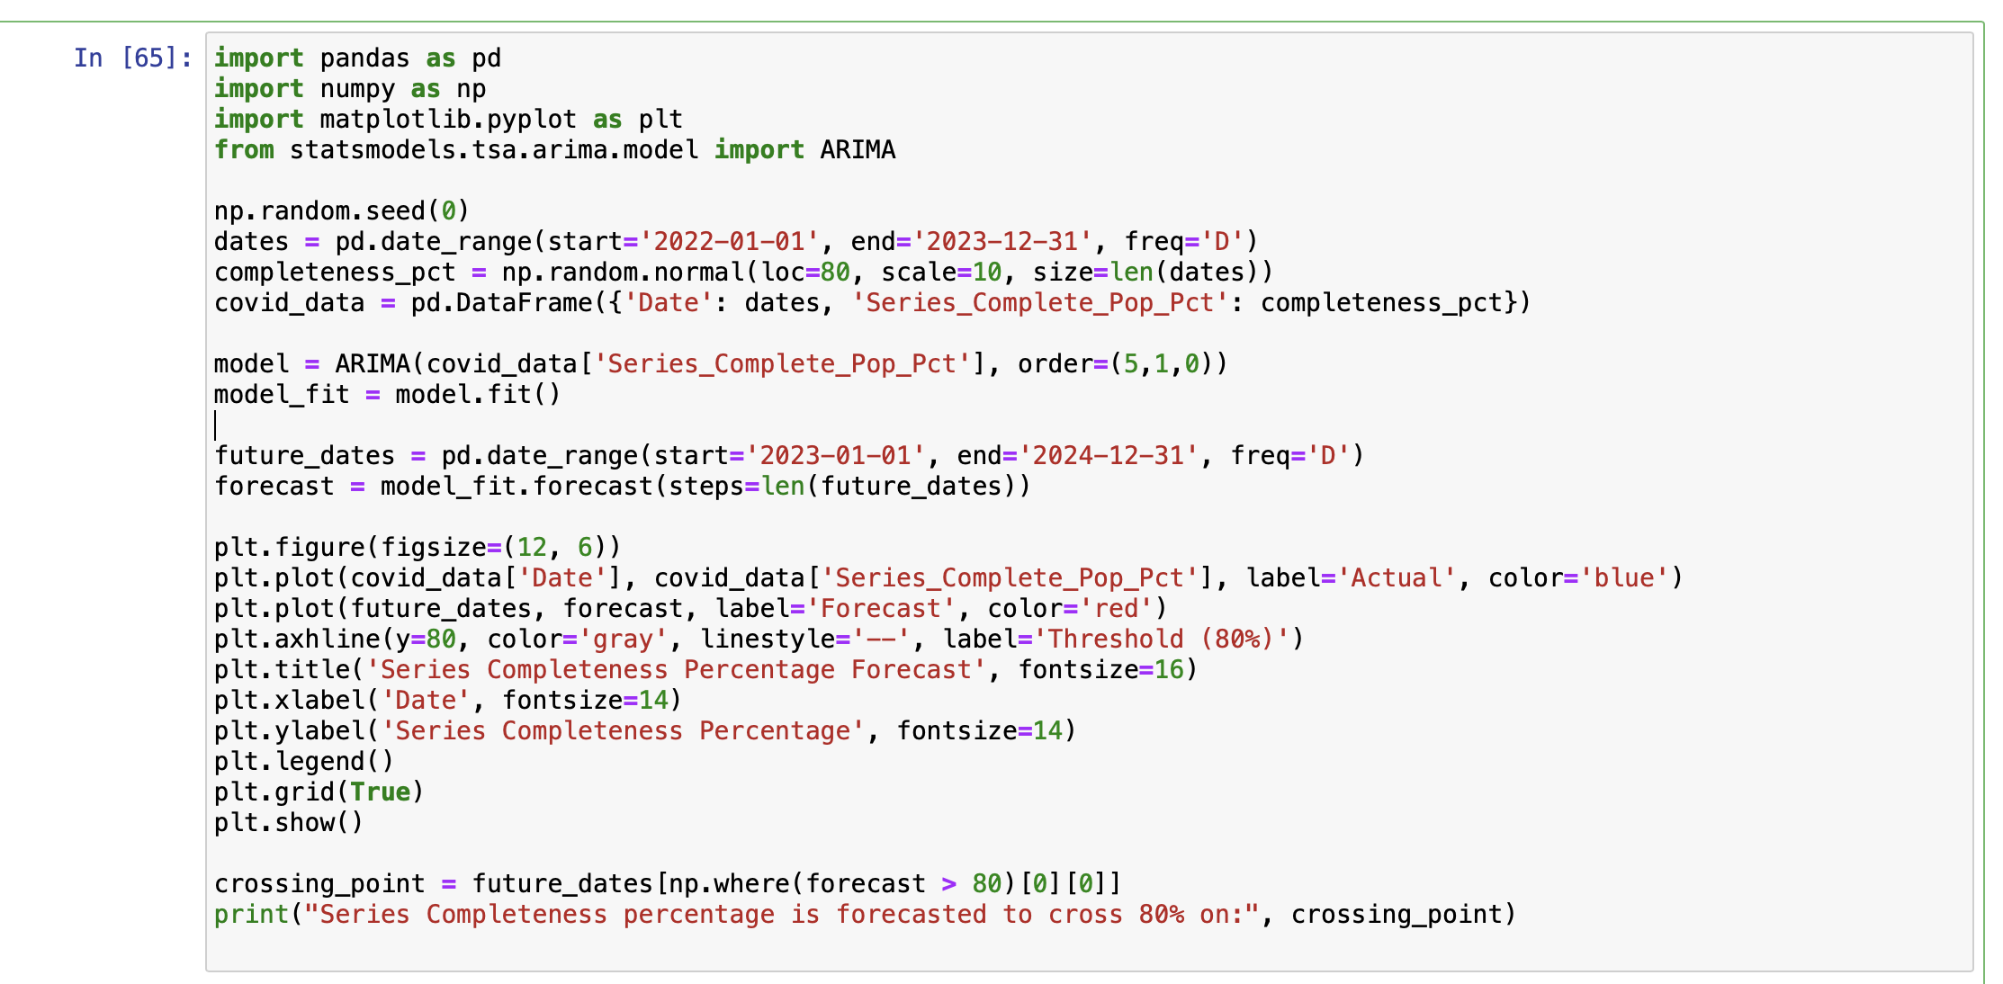
ARIMA Code to predict vaccination Percentage

Slide 23
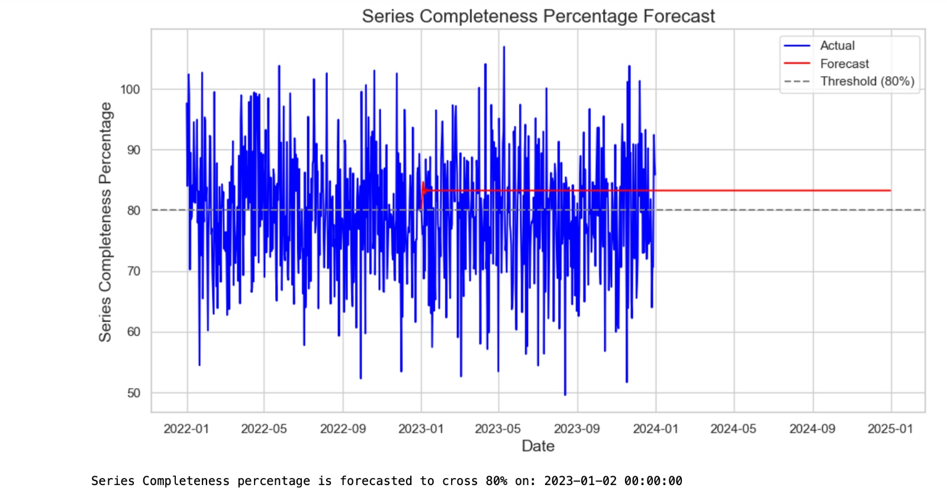
Prediction using ARIMA model

Slide 24
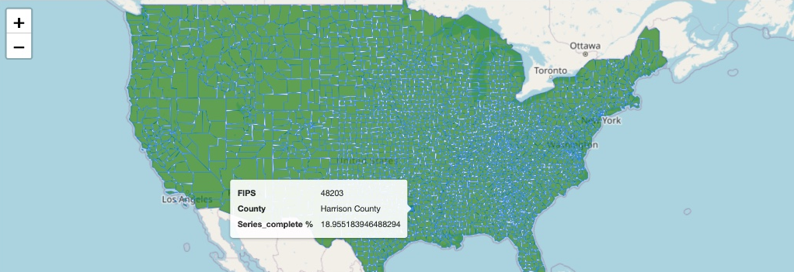
Results and Feedback
Mapping Counties with their respective vaccination completion rates

Slide 25
What did we learn?
How several factors influence vaccination rates?
County-level relationship between various factors and vaccination rates.

Slide 26
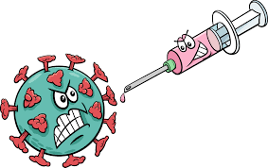
Future Scope
Look at more factors and datasets.
Using Google Maps to better illustrate vaccine and differences in factors.
Future predictions may be made with multi-factor regression and machine learning understanding.
Models may be developed to forecast vaccination rates in certain populations.

Slide 27
THANK YOU☺
Alekhya Kotha
2250483
Mohammed Zain Badal
2304618
Pratyusha Gadasanthala
2299853
Haricharan Mukthineni
2249340
Pallavilatha Vadlamudi
2288983

